Slide 1

Build tools
And more...

Slide 2
Build software?

Slide 3

Build software?

Slide 4
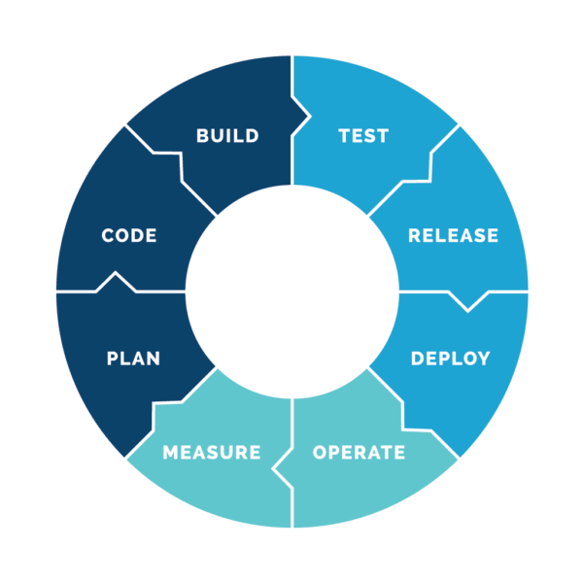

Slide 5
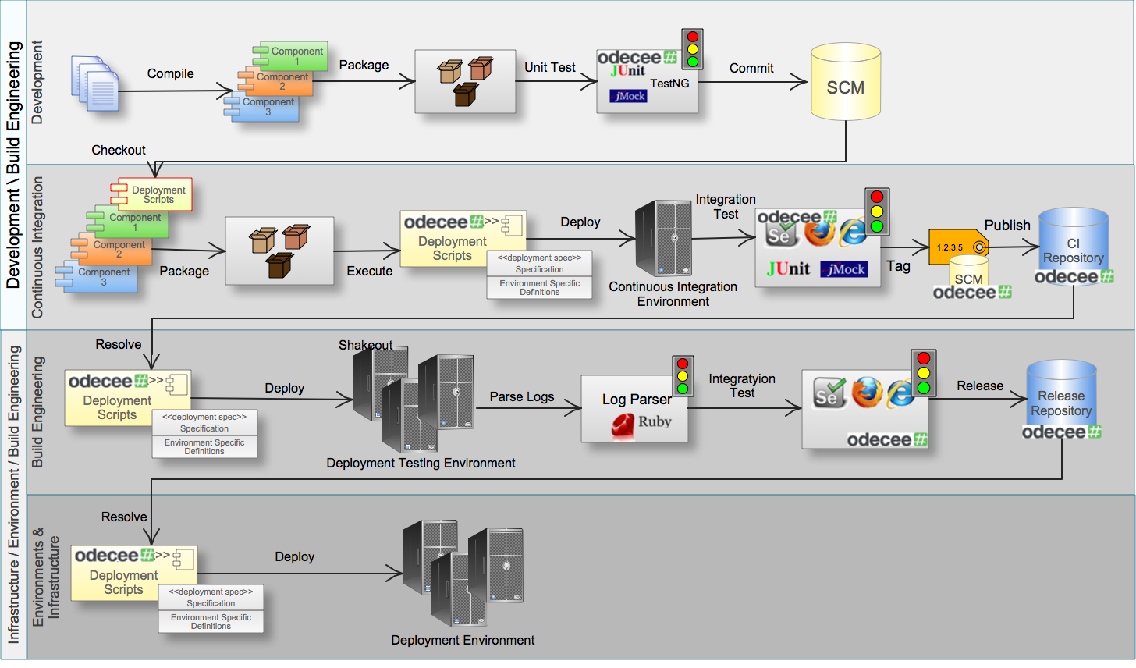

Slide 6

History...
of computers…
actually of build tools...

Slide 7


First build tools

Slide 8
First build tools
<?xml version="1.0"?> <project name="Hello" default="compile"> <target name="clean" description="remove intermediate files"> <delete dir="classes"/> </target> <target name="clobber" depends="clean" description="remove all artifact files"> <delete file="hello.jar"/> </target> <target name="compile" description="compile the Java source code to class files"> <mkdir dir="classes"/> <javac srcdir="." destdir="classes"/> </target> <target name="jar" depends="compile" description="create a Jar file for the application"> <jar destfile="hello.jar"> <fileset dir="classes" includes="**/*.class"/> <manifest> <attribute name="Main-Class" value="HelloProgram"/> </manifest> </jar> </target> </project>
all: hello hello: main.o factorial.o hello.o g++ main.o factorial.o hello.o -o hello main.o: main.cpp g++ -c main.cpp factorial.o: factorial.cpp g++ -c factorial.cpp hello.o: hello.cpp g++ -c hello.cpp clean: rm *o hello

Slide 9


Slide 10
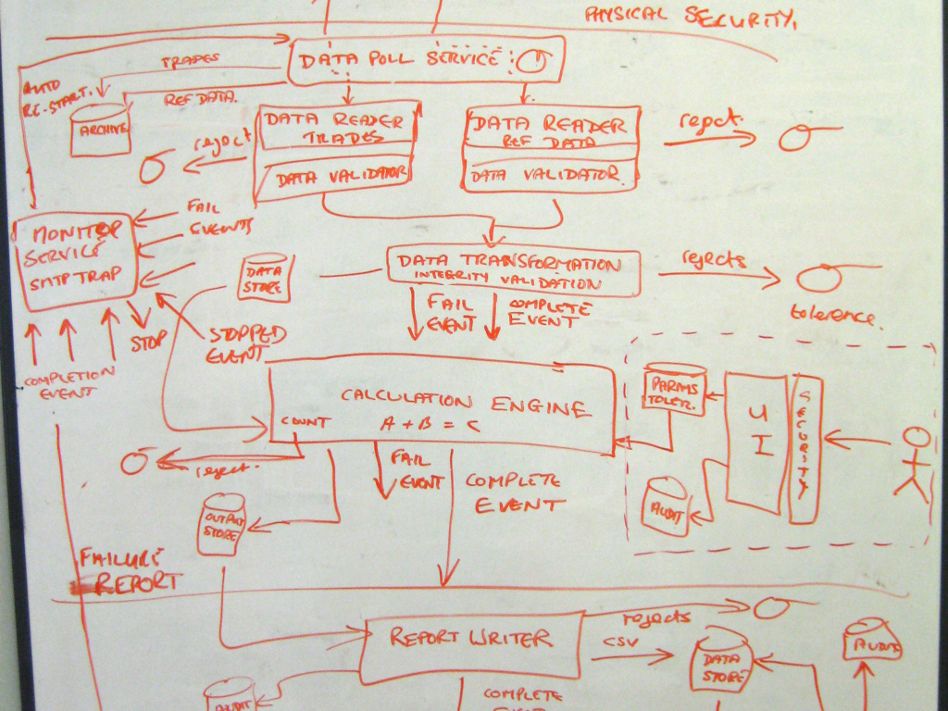
Present
of software…
and build tools...
and more...

Slide 11
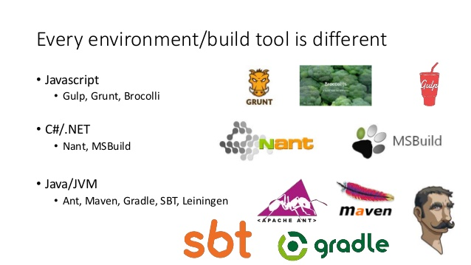

Slide 12
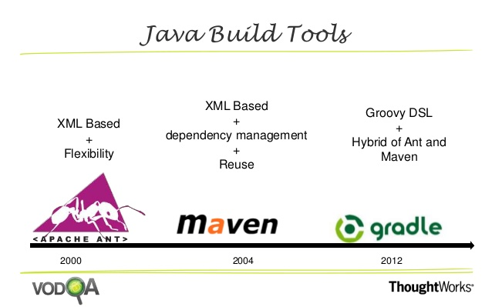

Slide 13


Slide 14

Convention over configuration
Dependency management
Build lifecycle
Plugins
Universally reusable
Common interface
Standard structure
Much more...

Slide 15
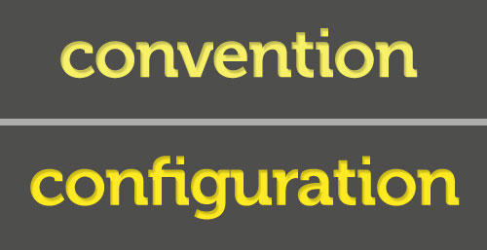

Slide 16
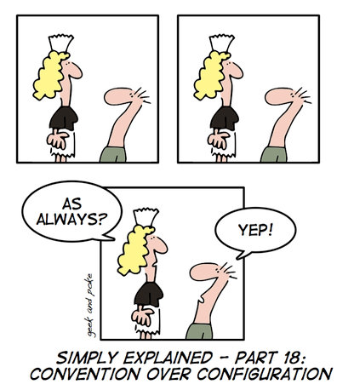

Slide 17


Slide 18
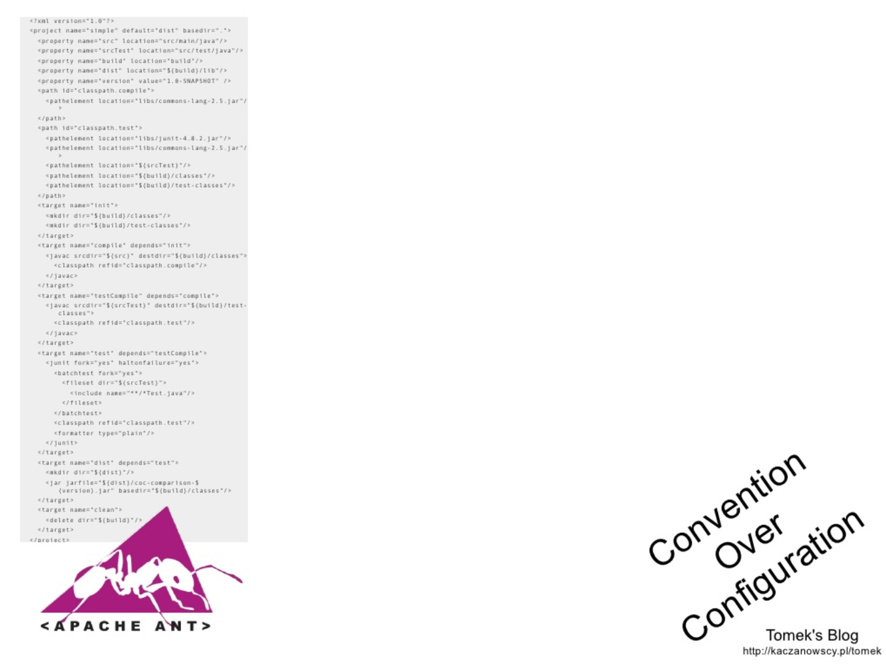

Slide 19
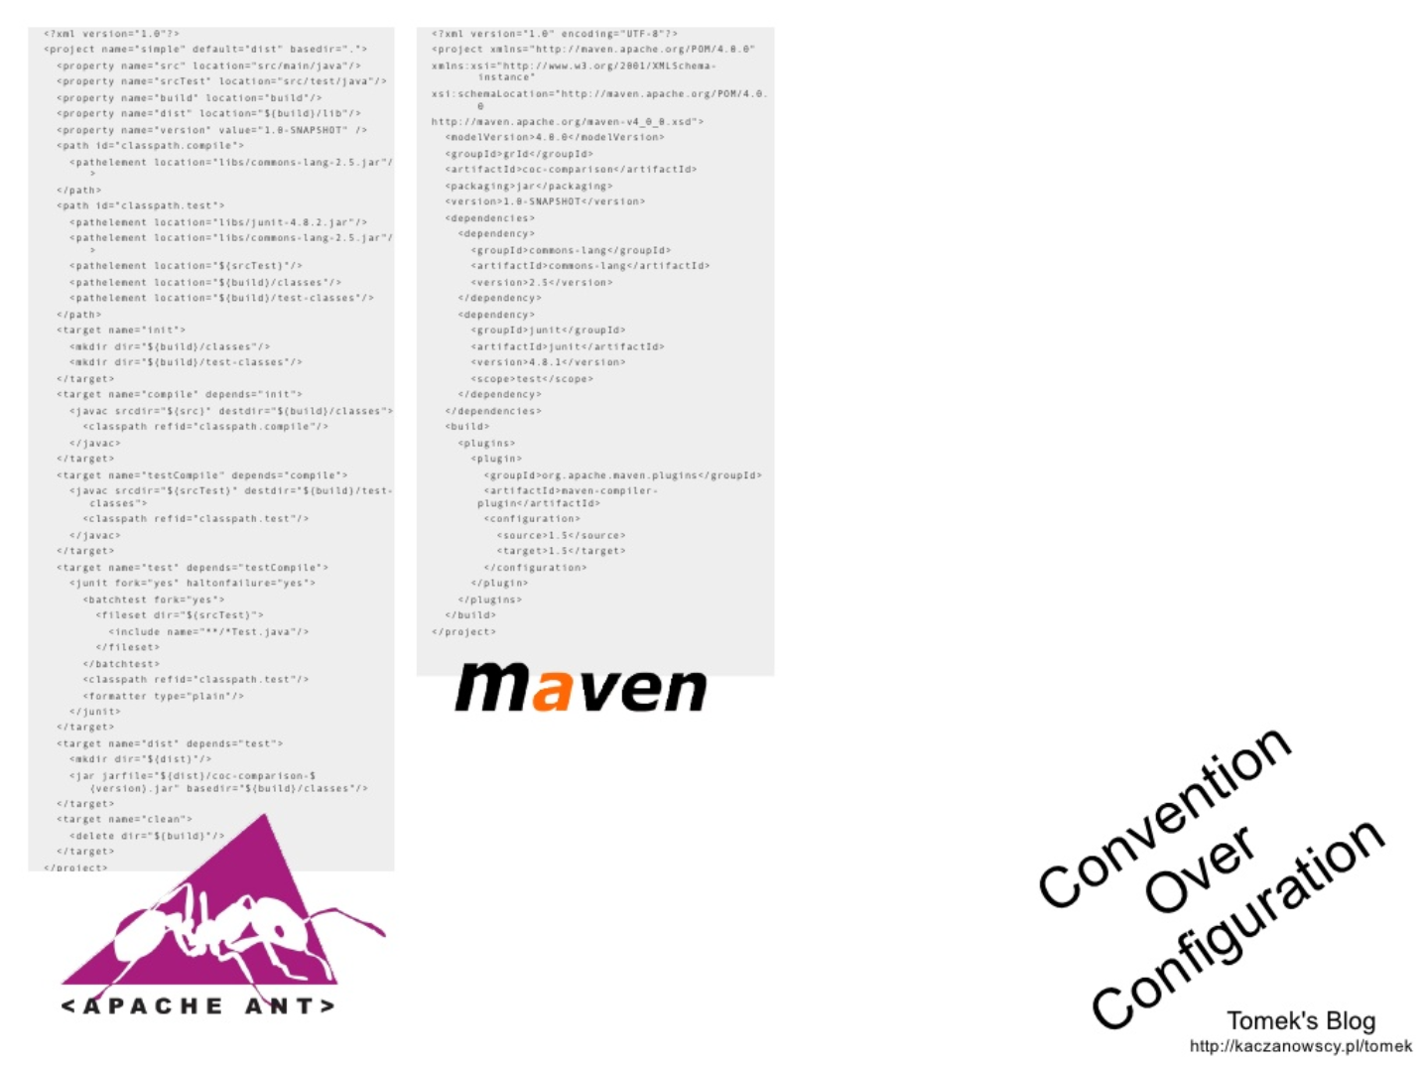

Slide 20
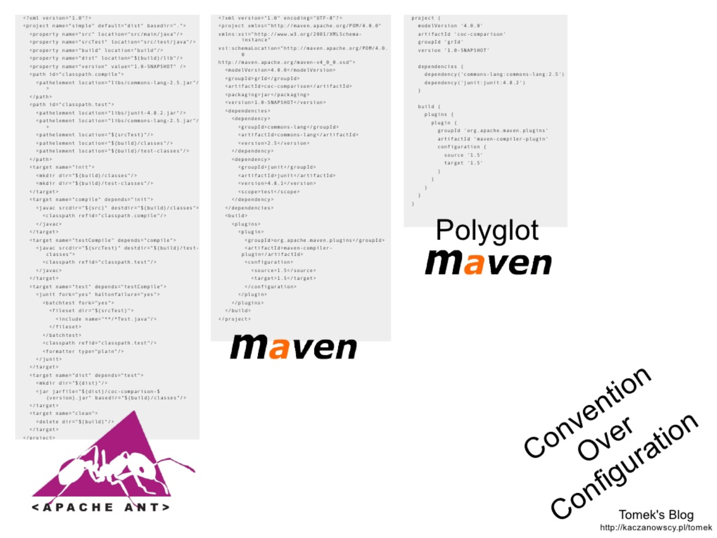

Slide 21
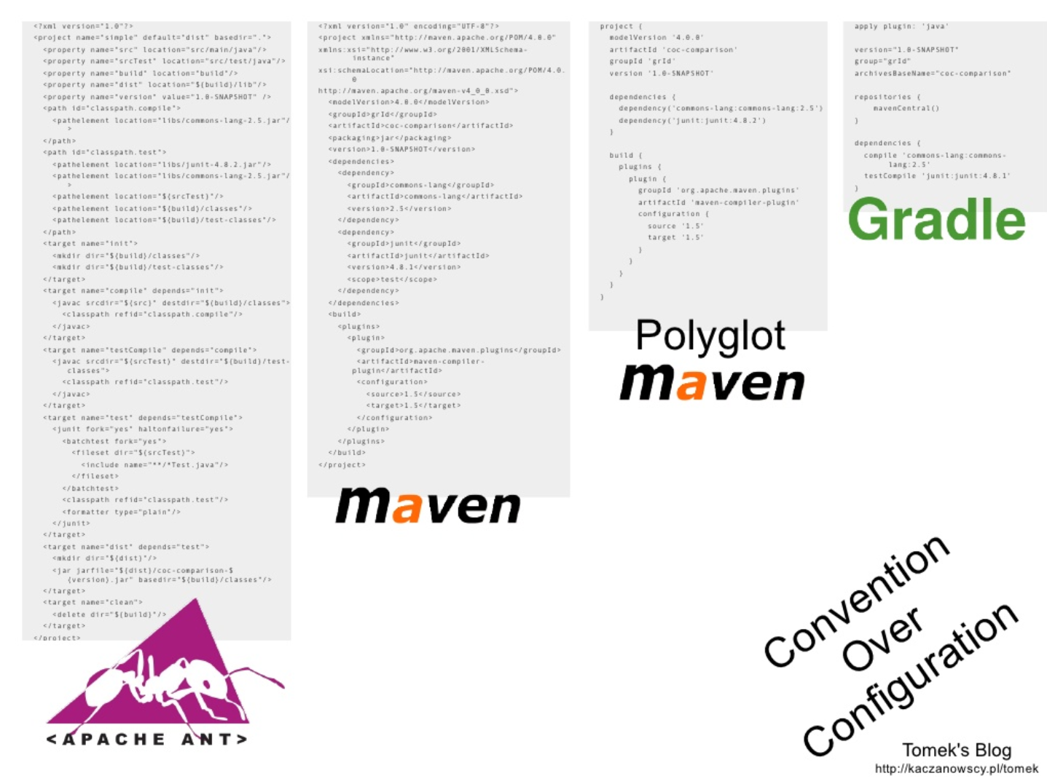

Slide 22
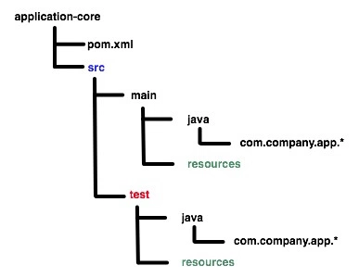
Standard
Project Structure

Slide 23
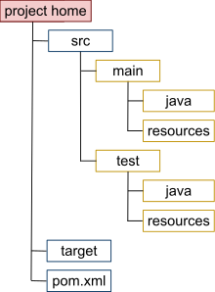
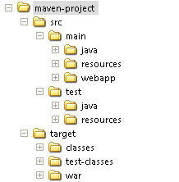
Maven project structure

Slide 24

P.O.M

Slide 25
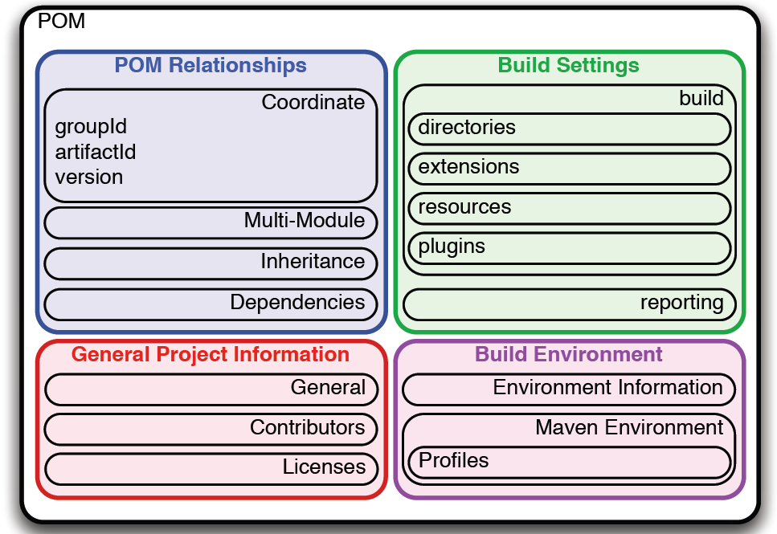
Project
Object
Model

Slide 26
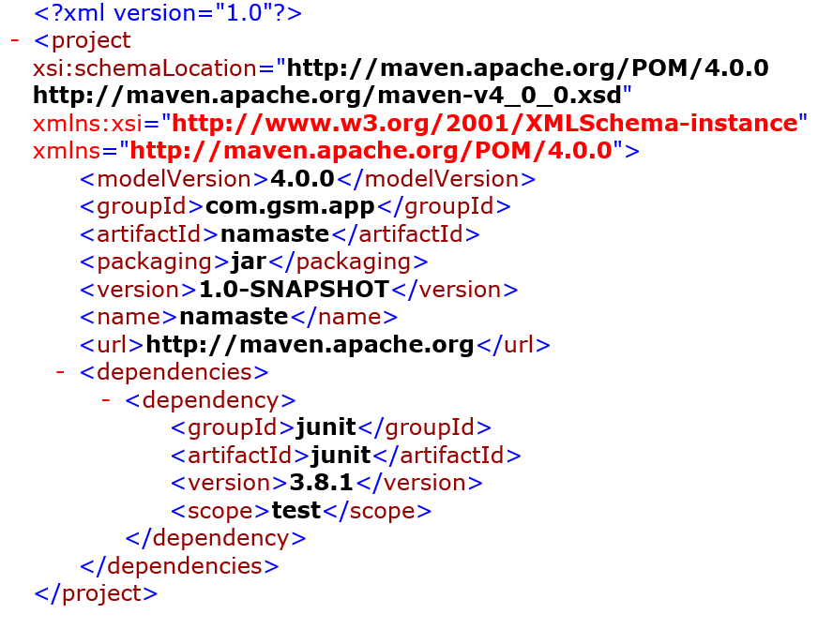
P.O.M.

Slide 27
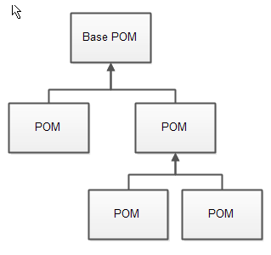
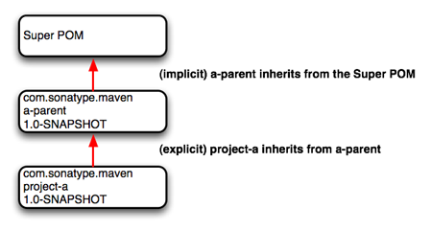
P.O.M. Inheritance

Slide 28
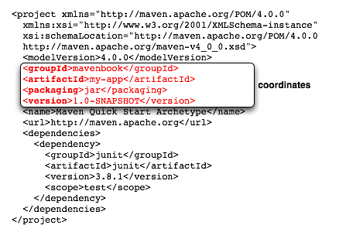
Dependencies

Slide 29
groupId:artifactId:packaging:version
<groupId>com.example</groupId>
<artifactId>proj-name</artifactId>
<version>0.0.1-SNAPSHOT</version>
<packaging>pom</packaging>
com.example:proj-name:jar:0.0.1-SNAPSHOT

Slide 30
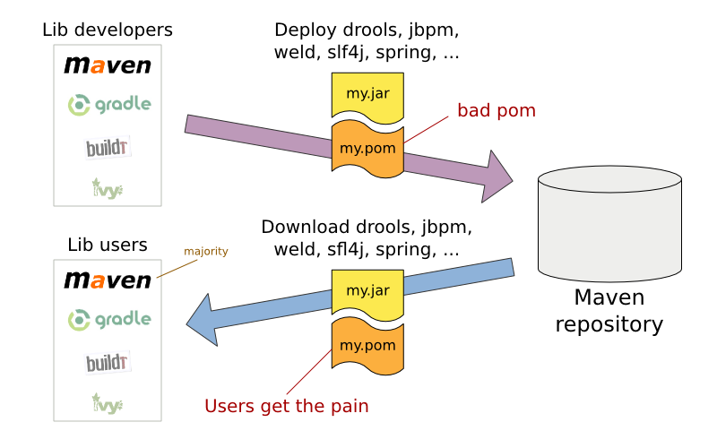

Slide 31
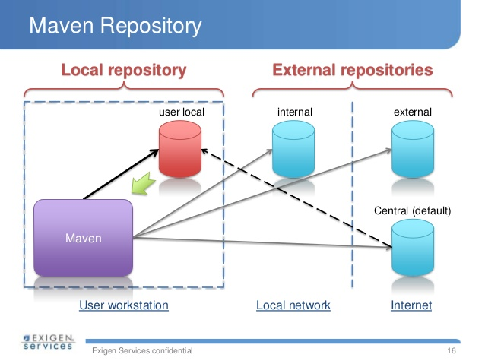

Slide 32
Popular maven Repos
mavenCentral
JCenter
JBoss
~/.m2
https://mvnrepository.com/
https://bintray.com/bintray/jcenter
http://repository.jboss.com/maven2/
C:\Users\{your_username}\.m2
~/.m2

Slide 33
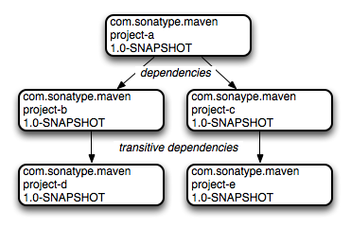
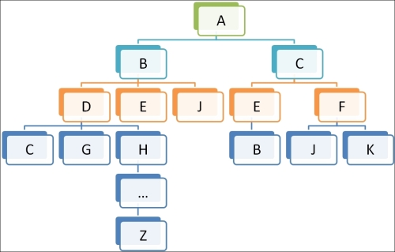
Transitive dependencies

Slide 34
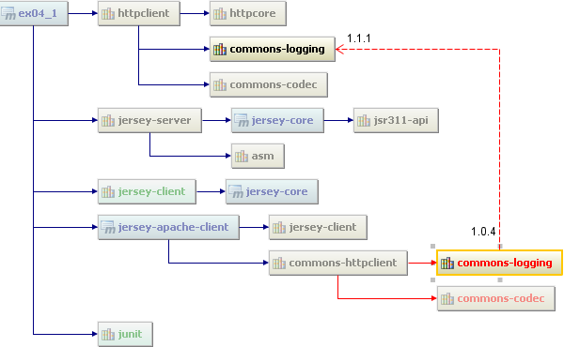
Dependency conflicts

Slide 35


Slide 36
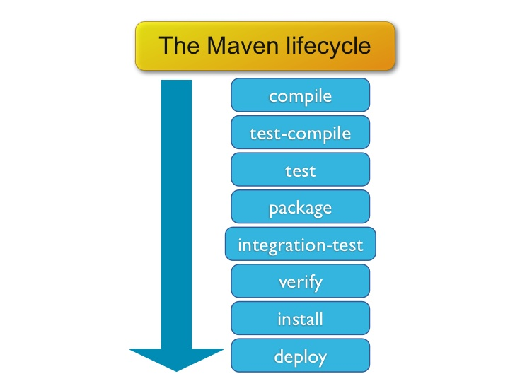
Lifecycle

Slide 37
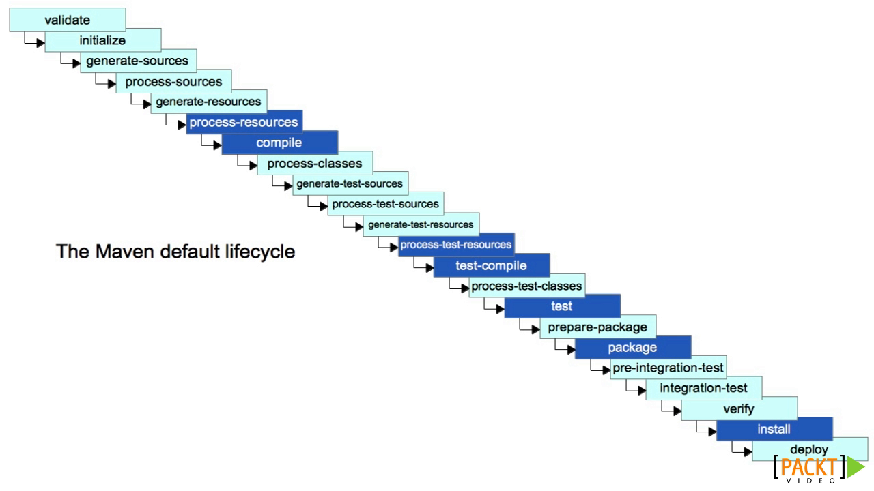

Slide 38
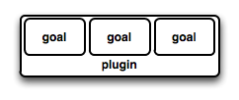
Plugins
&
Goals
<plugin_name>:<goal_name>
compiler:compile

Slide 39
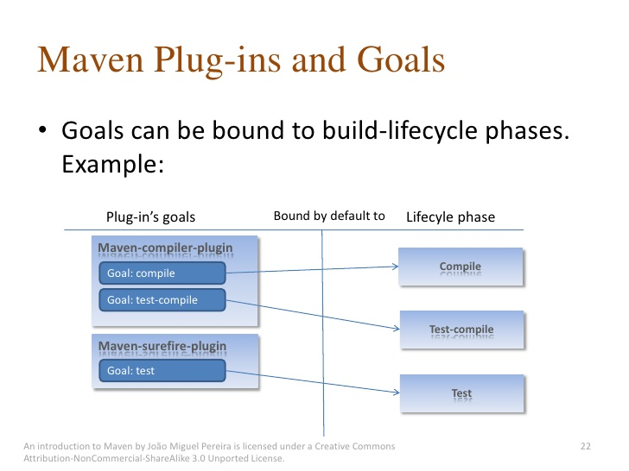

Slide 40
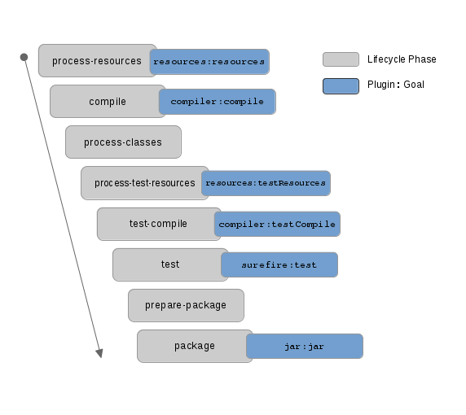

Slide 41
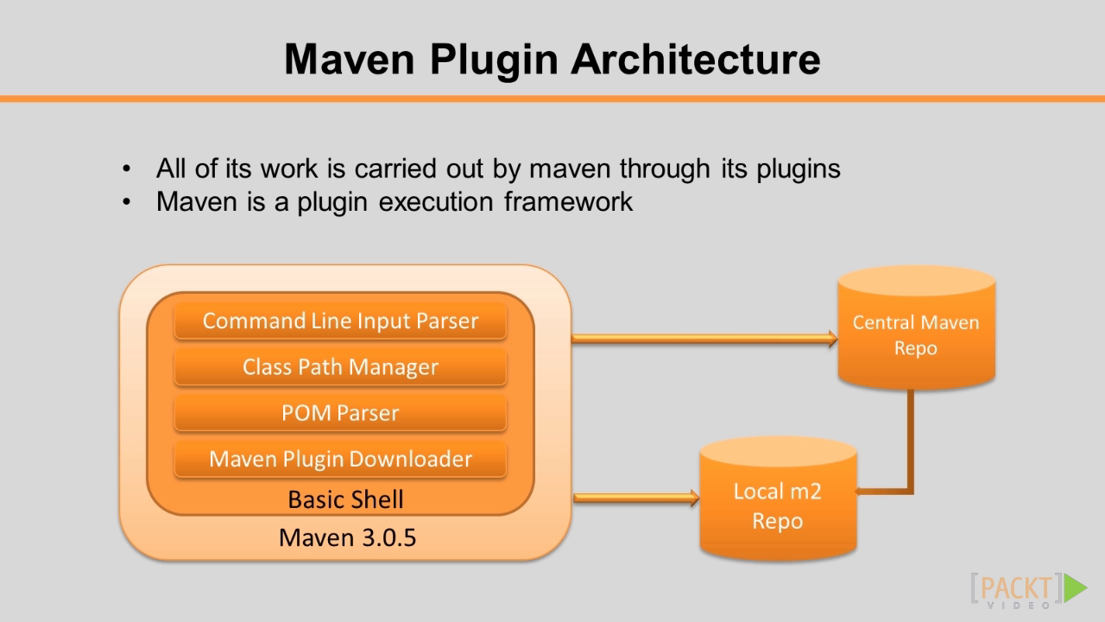

Slide 42
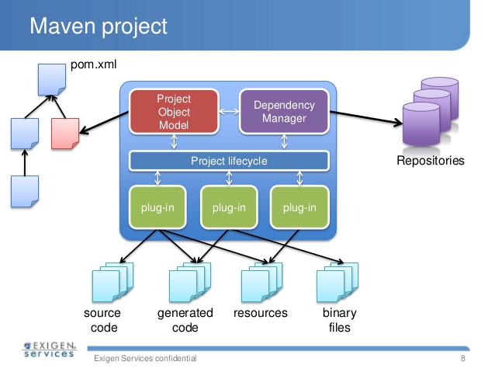

Slide 43


Slide 44

Build by convention
Supports all Maven conventions
DSL
Groovy
Gradle Wrapper
Easy Migration

Slide 45

Groovy
based DSL
(Domain Specific Language)

Slide 46
apply plugin: 'java'
apply plugin: 'eclipse'
apply plugin: 'idea'
apply plugin: 'org.springframework.boot'
group = 'devex.project'
version = '0.0.1-SNAPSHOT'
sourceCompatibility = 1.8
targetCompatibility = 1.8
repositories {
mavenCentral()
maven{
url "https://mvnrepository.com/artifact/org.apache.commons/commons-io"
}
}
dependencies {
compile("org.springframework.boot:spring-boot-starter:2.5.0")
compile("org.springframework:spring-web")
compile("com.fasterxml.jackson.core:jackson-databind")
// https://mvnrepository.com/artifact/org.apache.commons/commons-io
compile group: 'org.apache.commons', name: 'commons-io', version: '1.3.2'
compile group: 'commons-codec', name: 'commons-codec', version: '1.9'
testCompile("junit:junit")
}

Slide 47
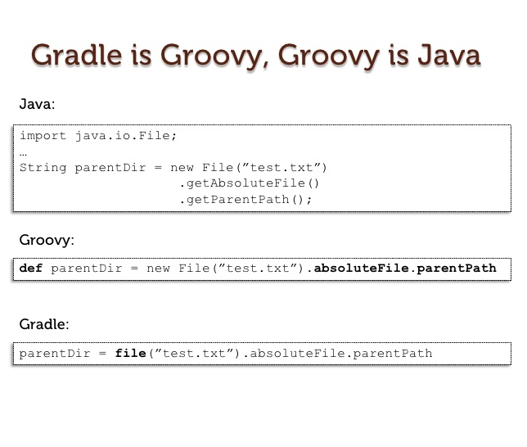

Slide 48

Gradle Wrapper
gradle wrapper
->
gradlew
gradlew.bat

Slide 49
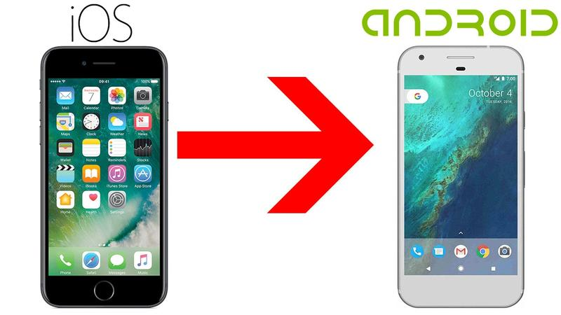



Easy Migration

Slide 50


gradle init

Slide 51
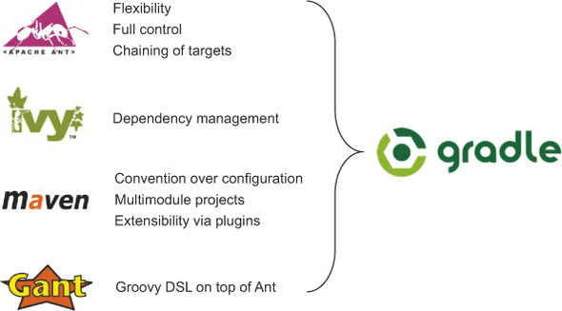

Slide 52
Gradle Structure
The Java plugin tasks:
build, compileJava, assemble, jar, test, testJava, ...
Plugin
Task
Task
Task
Task
Task
Task
Plugins
Tasks
Dependencies

Slide 53
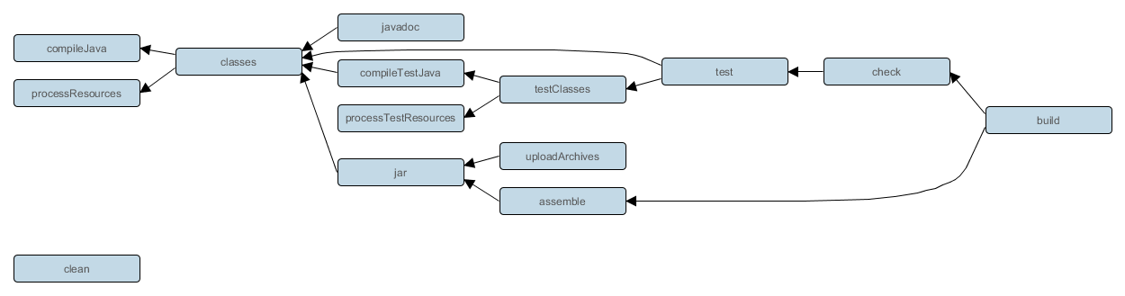
The Java plugin tasks and dependencies

Slide 54
Comparison with examples

Slide 55


Slide 56
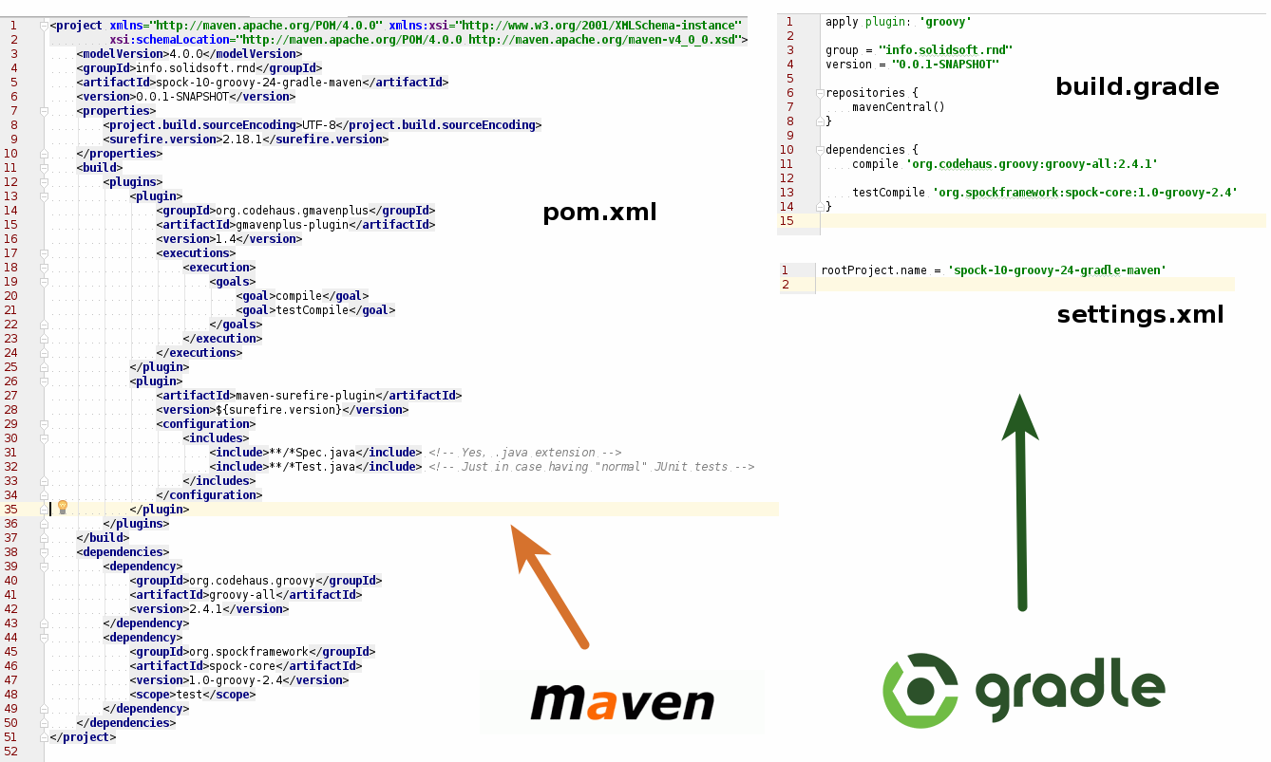
settings.gradle

Slide 57
Terminology
pom.xml
plugins & goals
lifecycle phases
XML
build.gradle
plugins & tasks
task dependencies
Groovy based DSL

Slide 58
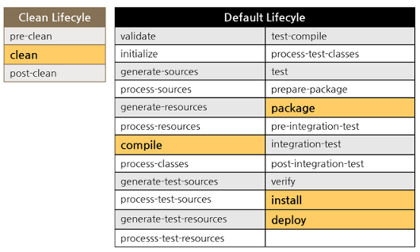
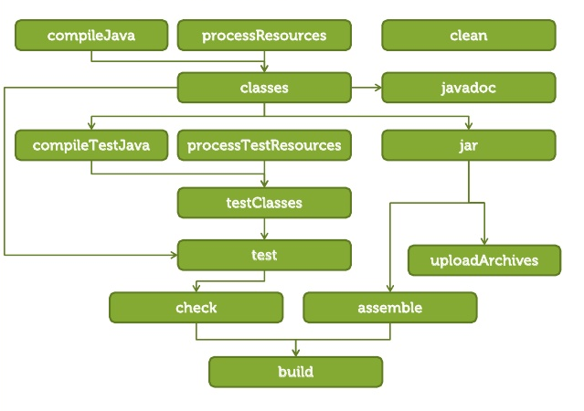
Lifecycle
Execution order

Slide 59
Generate a new project
$ mvn archetype:generate -DgroupId=org.example.myorg
$ gradle init --type java-application
OR JUST
$ gradle init
OVER THE CREATED MAVEN APPLICATION

Slide 60
Generate a new project
// Apply the java plugin to add support for Java
apply plugin: 'java'
// Apply the application plugin to add support for building an application
apply plugin: 'application'
// In this section you declare where to find the dependencies of your project
repositories {
// Use jcenter for resolving your dependencies.
// You can declare any Maven/Ivy/file repository here.
jcenter()
}
dependencies {
// This dependency is found on compile classpath of this component and consumers.
compile 'com.google.guava:guava:22.0'
// Use JUnit test framework
testCompile 'junit:junit:4.12'
}
// Define the main class for the application
mainClassName = 'App'
<project xmlns="http://maven.apache.org/POM/4.0.0" xmlns:xsi="http://www.w3.org/2001/XMLSchema-instance"
xsi:schemaLocation="http://maven.apache.org/POM/4.0.0 http://maven.apache.org/xsd/maven-4.0.0.xsd">
<modelVersion>4.0.0</modelVersion>
<groupId>org.example.myorg</groupId>
<artifactId>simple-example-project</artifactId>
<version>1.0-SNAPSHOT</version>
<packaging>jar</packaging>
<name>simple-example-project</name>
<url>http://maven.apache.org</url>
<properties>
<project.build.sourceEncoding>UTF-8</project.build.sourceEncoding>
</properties>
<dependencies>
<dependency>
<groupId>junit</groupId>
<artifactId>junit</artifactId>
<version>3.8.1</version>
<scope>test</scope>
</dependency>
</dependencies>
</project>

Slide 61
Generate a new project
apply plugin: 'java'
apply plugin: 'maven'
group = 'org.example.myorg'
version = '1.0-SNAPSHOT'
description = """simple-example-project"""
sourceCompatibility = 1.5
targetCompatibility = 1.5
tasks.withType(JavaCompile) {
options.encoding = 'UTF-8'
}
repositories {
maven { url "http://repo.maven.apache.org/maven2" }
}
dependencies {
testCompile group: 'junit', name: 'junit', version:'3.8.1'
}
<project xmlns="http://maven.apache.org/POM/4.0.0" xmlns:xsi="http://www.w3.org/2001/XMLSchema-instance"
xsi:schemaLocation="http://maven.apache.org/POM/4.0.0 http://maven.apache.org/xsd/maven-4.0.0.xsd">
<modelVersion>4.0.0</modelVersion>
<groupId>org.example.myorg</groupId>
<artifactId>simple-example-project</artifactId>
<version>1.0-SNAPSHOT</version>
<packaging>jar</packaging>
<name>simple-example-project</name>
<url>http://maven.apache.org</url>
<properties>
<project.build.sourceEncoding>UTF-8</project.build.sourceEncoding>
</properties>
<dependencies>
<dependency>
<groupId>junit</groupId>
<artifactId>junit</artifactId>
<version>3.8.1</version>
<scope>test</scope>
</dependency>
</dependencies>
</project>

Slide 62
Dependency
<dependencies>
<dependency>
<groupId>com.google.guava</groupId>
<artifactId>guava</artifactId>
<version>22.0</version>
<scope>compile</scope>
</dependency>
<dependency>
<groupId>junit</groupId>
<artifactId>junit</artifactId>
<version>3.8.1</version>
<scope>test</scope>
</dependency>
</dependencies>
dependencies {
compile 'com.google.guava:guava:22.0'
// Use JUnit test framework
testCompile 'junit:junit:4.12'
}

Slide 63
Plugins
<build>
<pluginManagement>
<plugins>
<plugin>
<groupId>org.apache.maven.plugins</groupId>
<artifactId>maven-compiler-plugin</artifactId>
<configuration>
<source>1.5</source>
<target>1.5</target>
</configuration>
</plugin>
</plugins>
</pluginManagement>
</build>
apply plugin: 'java'
apply plugin: 'maven'

Slide 64
Building, Packaging and installing a java jar application
mvn package
mvn install
gradle build
gradle assemble
gradle install
(apply plugin: ‘maven’)

Slide 65
Multimodule support
rootProject.name = 'simple-parent'
include ':simple-command'
include ':simple-model'
include ':simple-weather'
include ':simple-persist'
include ':simple-webapp'
project(':simple-command').projectDir = "$rootDir/simple-command”
project(':simple-model').projectDir = "$rootDir/simple-model"
project(':simple-weather').projectDir = "$rootDir/simple-weather"
project(':simple-persist').projectDir = "$rootDir/simple-persist"
project(':simple-webapp').projectDir = "$rootDir/simple-webapp"
<modelVersion>4.0.0</modelVersion>
<parent>
<groupId>org.sonatype.mavenbook.multispring</groupId>
<artifactId>parent</artifactId>
<version>0.8-SNAPSHOT</version>
</parent>
<artifactId>simple-parent</artifactId>
<packaging>pom</packaging>
<name>Multi-Spring Chapter Simple Parent Project</name>
<modules>
<module>simple-command</module>
<module>simple-model</module>
<module>simple-weather</module>
<module>simple-persist</module>
<module>simple-webapp</module>
</modules>
In settings.gradle

Slide 66
Multimodule support
<build>
<pluginManagement>
<plugins>
<plugin>
<groupId>org.apache.maven.plugins</groupId>
<artifactId>maven-compiler-plugin</artifactId>
<configuration>
<source>1.5</source>
<target>1.5</target>
</configuration>
</plugin>
</plugins>
</pluginManagement>
</build>
<dependencies>
<dependency>
<groupId>junit</groupId>
<artifactId>junit</artifactId>
<version>4.12</version>
<scope>test</scope>
</dependency>
</dependencies>
</project>
allprojects {
apply plugin: 'maven'
group = 'org.sonatype.mavenbook.multispring'
version = '0.8-SNAPSHOT'
}
subprojects {
apply plugin: 'java'
sourceCompatibility = 1.5
targetCompatibility = 1.5
repositories {
mavenLocal()
maven { url "http://repo.maven.apache.org/maven2" }
}
dependencies {
testCompile group: 'junit', name: 'junit', version: '4.12'
}
}

Slide 67
Final comparison

Slide 68
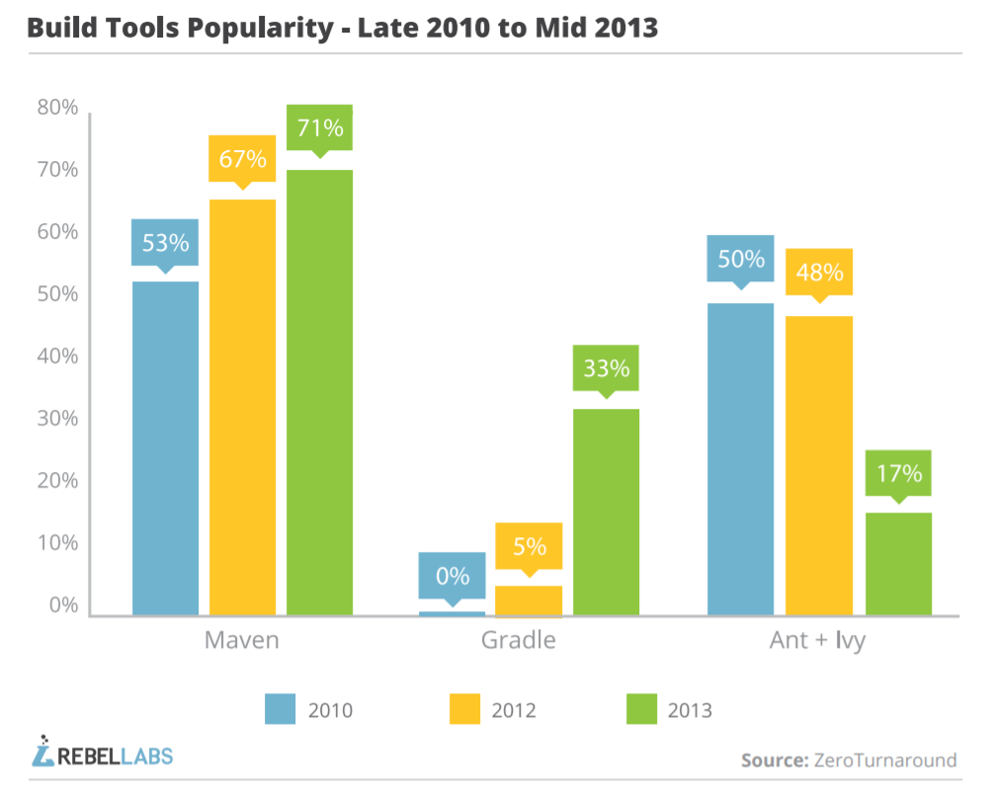

Slide 69
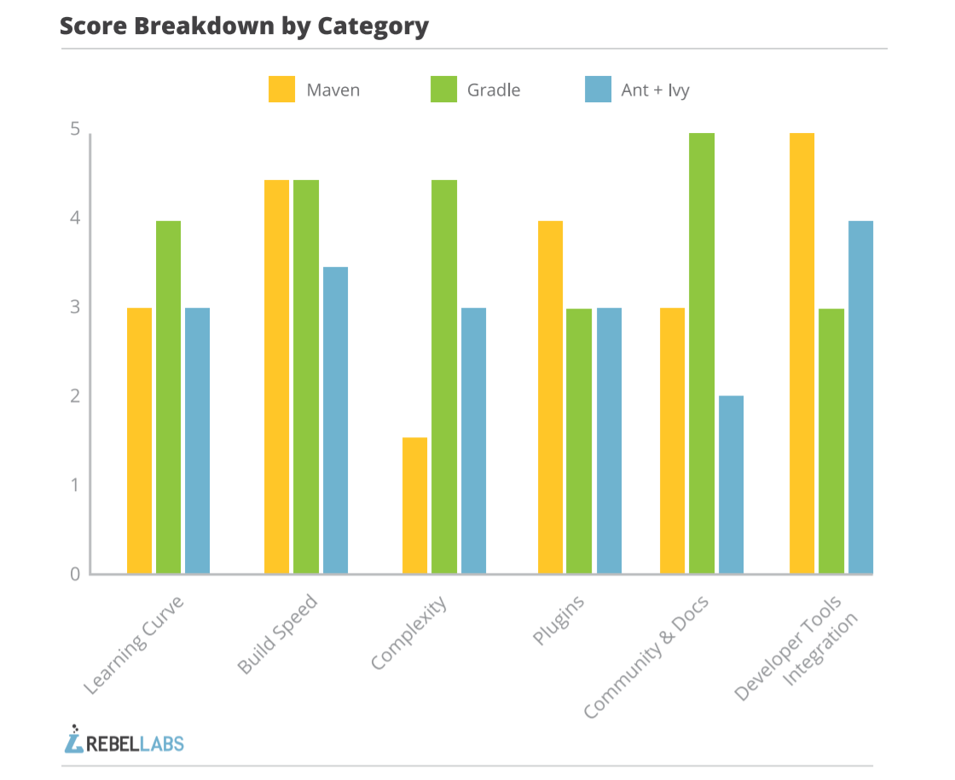

Slide 70
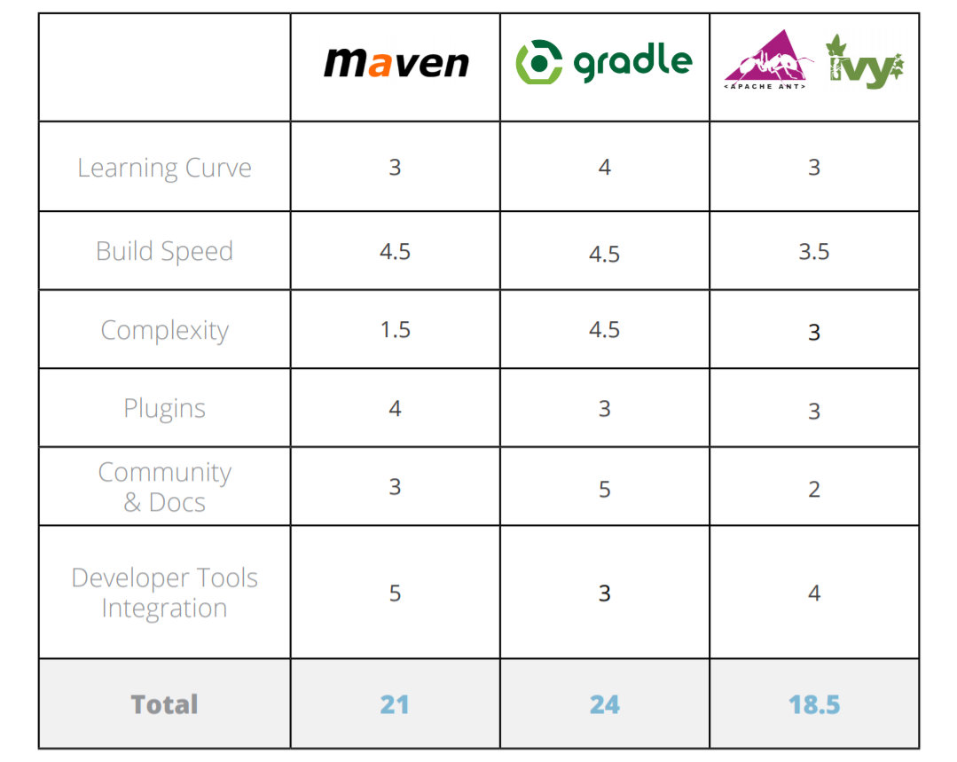

Slide 71
Bibliography and References
https://fr.slideshare.net/tomek_k/convention-over-configuration-maven-3-polyglot-maven-gradle-and-ant
https://www.slideshare.net/joaomiguel.pereira/an-introduction-to-maven
http://www.lihaoyi.com/post/WhatsinaBuildTool.html
http://books.sonatype.com/mvnex-book/reference/index.html
https://docs.gradle.org/current/userguide/userguide.html
https://zeroturnaround.com/rebellabs/java-build-tools-part-2-a-decision-makers-comparison-of-maven-gradle-and-ant-ivy/

